Slide 1
T Helper 17 (Th 17)
Presented by Arash Maleki, M.D.

Slide 2
CD4+ T helper (Th) cells have the major role in diverse immune responses.
Naive T cells are differentiated to effector CD4+ Th cells via T cell receptor engagement in conjunction with co-stimulatory molecules and cytokines milieu. (Th 1 and Th 2)
CD4+ T cells can also produce regulatory subsets (Treg cells) which express forkhead box P3 (FoxP3) gene and produce cytokines such as transforming growth factor (TGF)-β, IL-10 and IL-35.
Third group of CD4+ Th cell , called Th17 cells, with the capacity of secreting IL-17 but not IFN-γ or IL-4 has been identified lately.

Slide 3
Where does the concept of Th 17 come from?
The first clue for the other subtype of CD4+ Th cells (Th 17) came from experimental autoimmune encephalomyelitis (EAE), the model of multiple sclerosis (MS) in mice.
It was thought that Th 1 and related cytokines IL-12 and IFNγ were responsible for disease progression.
However, mice with IFNγ−/−, IFNγR−/−, IL-12βR−/−, and IL-12p35−/− genotype still showed progression of the disease.
Finally, in 2003, interleukin-23 (IL-23) was defined as critical cytokine in murine EAE by Cua et al.

Slide 4
Later, a protective role for IL-12 and IFNγ in collagen-induced arthritis (CIA) models Was showed. (Murphy et al.) It was thought to be a Th1 related reaction.
Finally, Murphy et al. concluded that IL-23 increased a subset of IL-17-producing CD4+ T cells production which caused further CIA progression.

Slide 5
Characteristics of human Th 17 cells
Human Th 17 cells are cells which characteristically produce IL-17A and IL-17F.
They also secret TNF-α, IL-6, IL-9, IL-10, IL-21, IL-22, IL-26, INF-γ and GM-CSF, vary depending on the cytokine milieu in which the differentiation occurs. (most proinflammatory: IL-17A, IL-21, TNF-α)
In terms of chemokine and cytokine receptor expression, they express CCR4, CCR6 and IL-23R, but not CXCR3.
IL-17 is responsible for many of the known proinflammatory functions of Th 17 cells.

Slide 6
T helper 17 differentiation
IL-1β, IL-6 and/or IL-23 and TGF β-1 separately or in combination can stimulate the development of Th 17 cells. IL-6 and TGFβ -1 initiate differentiation while IL-23 are important for expansion and activation.
Notably, some combinations such as IL-6 and TGF-β make Th17 cells more pathogenic than those derived from IL-6 or TGF-β alone.
Prostaglandin E2 (PGE2) also directly helps in the differentiation, expansion and functioning of Th 17 cells. (colitis in IBD)
PGE2 up-regulates IL-23R and IL-1R which can induce expression of Th 17 transcription factors and cytokine and chemokine/chemokine receptor.

Slide 7
It was shown that high levels of sodium chloride induce an increase in Th17 cells that were shown to be highly stable and pathogenic. (Kleinewietfeld et al)
Increased sodium chloride level induces IL-23R expression and Th17 proliferation.

Slide 8
Th 17 cell Transcription factors
Studies in mice have identified 5 TFs including Ror-γt, Ror-αd, Irf-4, STAT3 and AhR.
Ror-γt appears to be the most specific for Th 17 cells and is known as Th 17 lineage defining transcription factor.
Significant reduction in Th 17 cells number in the gut has been reported in Ror-γ t deficient mice which protects them from EAE . Moreover, over expression, promotes Th 17 development.
Ror-αd may act in synergy with Ror-γt.
Irf-4 is a transcription factor which may upstream both Ror-αd and Ror-γt.

Slide 9
STAT-3 is also important early in Th 17 lineage commitment and STAT-3-deficient mice have less Th 17 cells and lower Ror-γt expression.
AhR is also able to regulate Th 17 cells. FICZ (6-formylindolo (3,2-b) carbazole), a ‘natural’ AhR ligand, increases Ror-γt expression expands Th 17 cells, and therefore causes more severe EAE.
RORC2 is the major transcription factor in humans and it is similar to Ror-γt in mice.
RORC2 over expression results in expression of CCR6, CCR4, CD161, down regulation of CXCR3 and increasing of Th 17 related cytokines.

Slide 10
Ror-αd and STAT3 also appears to be critical for the development of human Th 17 cells as RORC2 over-expression induces IL-17 in only 20% of T cells.

Slide 11
Negative Regulation of the Th 17
Both Th 1 and Th 2 cells counteract with each other, and their cytokines IFNγ and IL-4 decrease the expansion of Th 17 cells.
IL-25 takes immune responses toward the Th 2 phenotype and the sera and inflamed part of intestine of patients diagnosed with inflammatory bowel disease (IBD) contain less IL-25.
IL-27 has also been shown to down-regulate IL-17 secretion. IL-27 also suppresses the development of Th 17 cells. It suppresses IL-6-mediated T cell proliferation as IL-6 and IL-27 both signal through the shared receptor component gp-130 .

Slide 12
IL-2, a necessary cytokine for activated T lymphocytes and T-regs growth, also inhibit Th 17 expansion.
Vitamin D can also down-regulate Th 17 production ( they have vit D receptors ) and treatment of EAE models with 1,25 Dihydroxyvitamin D3, improves the disease. (through suppression of cytokines at the protein level)
A metabolite of vitamin A, retinoic acid, also has a negative effect on Th 17 cell differentiation and function. ( it has been suggested that retinoic acid blocks the expression of IL-6 and IL-23R )
Interestingly 1,25 D3 and retinoic acid have synergistic effect on each other in inhibiting of both Th17 differentiation and expansion and decreasing Th17-related cytokines and transcription factors.

Slide 13
Sundrud et al. reported a small molecule known as halofuginone which specifically inhibits the development of mouse and human Th17 cells by amino acid deprivation mechanism which means these cells are very sensitive to stress and deprivation. ( Low IL-17A and IL-17F mRNA and similar to increasing unaminiacetylated tRNA ) ( Now used for fibrotic diseases such as graft-versus-host- disease and scleroderma)
However, halofuginone inhibits only the differentiation and not the other functions, of Th 17 cells, it may only be effective if used early in disease onset.

Slide 14
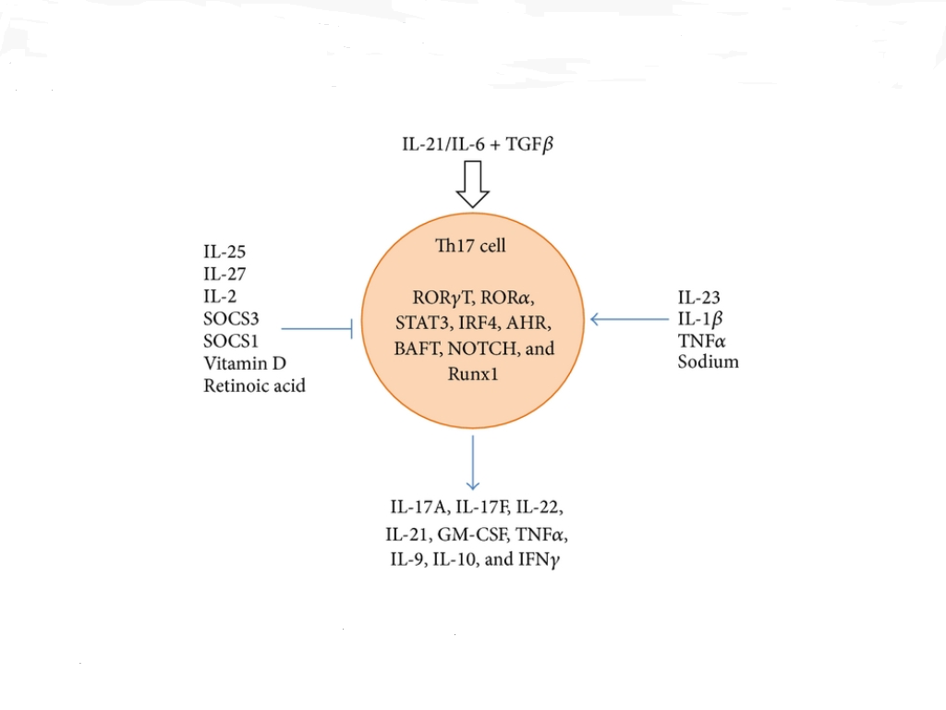
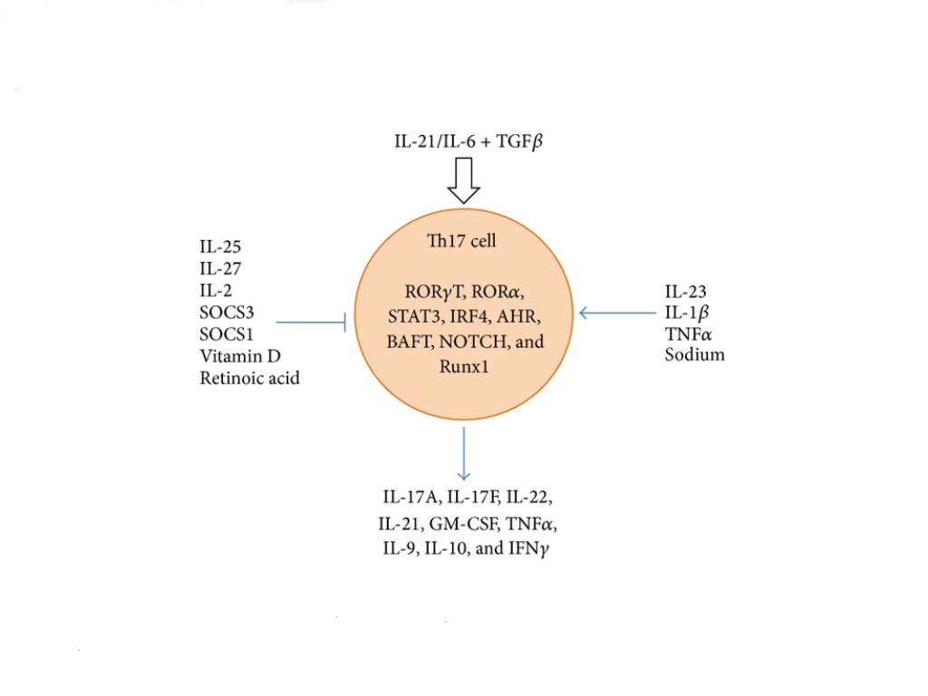
Suppressor of cytokine signaling
Simone Kennedy Bedoya, Brandon Lam, Kenneth Lau, and Joseph Larkin III. Th17 Cells in Immunity and Autoimmunity. Clinical and Developmental Immunology. Volume 2013, Article ID 986789, 16 pages

Slide 15
S. Q. Crome, A. Y. Wang and,M. K. Levings. Translational Mini-Review Series on Th17 Cells: Function and regulation of human T helper 17 cells in health and disease. Clin Exp Immunol.2010 Feb;159(2):109-19
Induction
suppresion
supression
Treg and Th 17
Has dual effect

Slide 16
Th 17 cells and other immune cells interactions
APCs:
Monocytes from RA patients accelerate the development of Th 17 but not Th 1 or Th 2 cells via cell contact dependent mechanism and LPS, IL-1β, TNF-α. (Evans et al.)
Vaknin-Dembinsky et al. showed that DCs from some patients with MS secret high levels of IL-23 compared to healthy controls.
DCs in psoriasis secret IL-1β, IL-23 and CCL20, causing development of Th 17 cells and their migration to the skin.
Evans et al. reported the importance of Toll-like receptor (TLR)-activation of monocytes for optimal induction of human Th 17. (receptors recognizing structurally conserved molecules derived from microbes)

Slide 17
S. Q. Crome, A. Y. Wang and,M. K. Levings. Translational Mini-Review Series on Th17 Cells: Function and regulation of human T helper 17 cells in health and disease. Clin Exp Immunol.2010 Feb;159(2):109-19

Slide 18
Th 17 cells and other immune cells interactions
B cells:
Th 17 cells increase production of IgM, IgG and IgA but not IgE.
Human allo-reactive Th 17 cell clones express the B cell chemoattractant CXCL13 which is highly expressed in synovial fluid of RA patients and attracts B cells to the site of inflammation.
However, it is not clear whether association of Th 17 cells with various allergic and autoimmune disorders is because of direct modification of B cells by Th 17 or another indirect interactions with other cells such as granulocytes.

Slide 19
Th17 cells and other immune cells interactions
CD4+ T effector cells:
IL-17 can modulate Th 1 differentiation by suppressing transcription of T-bet and other Th1-associated genes. However, some studies show increasing IL-2 expression which promotes T cell proliferation.
Interestingly, co-expressing IL-17 and IFN-γ, as well as T-bet and RORC2 cells can readily be isolated from human peripheral blood.
Recent studies showed significant potential for plasticity based on local cytokine milieu.

Slide 20
Th17 cells and other immune cells interactions
CD4+FoxP3+ Tregs:
Both cell types require TGF-β.
TGF-β alone induces Treg and its transcription factor ( FoxP3 ) and inhibits Th 17. However, TGF- β in addition to IL-6 promotes Th 17 transcription. ( IL-6 neutilizes TGF-β effect on Treg cells )
Tregs FoxP3 transcription factor modulates the function of both Ror-α and Ror-γt. (Du et al. and Ichiyama et al. )
Conversely, transient FoxP3 expression occurs during in vitro differentiation of Th 17 cells, raising the possibility that FoxP3 also has a role in the development of Th 17 cells.

Slide 21
S. Q. Crome, A. Y. Wang and,M. K. Levings. Translational Mini-Review Series on Th17 Cells: Function and regulation of human T helper 17 cells in health and disease. Clin Exp Immunol.2010 Feb;159(2):109-19

Slide 22
Tregs cells can differentiate into IL-17-producing cells in the presence of IL-1β, IL-23, IL-21 and IL-2. (Koenen et al.)
Several reports have also described populations of Treg cells that co-express FoxP3 and IL-17 and retain their suppressive functions.
It is currently unclear whether FoxP3+ IL-17+ T cells represent a transitional state or a unique lineage of Th cells.
Importance of Treg cells making IL-17, is in host defense , while serving simultaneously to control inflammation and autoimmunity.
It has been shown that human Th 17 cells are resistant to Treg-mediated suppression of proliferation and production of IL-17. However, Treg cells can suppress TNF-α and IL-6 produced by RORC2-transduced T cells.

Slide 23
Role of Th 17 in Human Health

Slide 24
Th 17 cells in human health
Th 17 cells have different effects on different cell types including epithelial, endothelial, and fibroblastic cells.
The Th 17 has a unique mechanism against bacterial and fungal pathogens through production and induction of various cytokines and other proteins.
IL-17 recruits neutrophils by inducing granulopoiesis and acts on macrophages to promote their recruitment and survival by CXC chemokine induction . A vital and key component of the innate immune response.
Th 17 cells are also necessary for complete vaccine protection against the 3 systemic mycoses including Coccidioidomycosis , Histoplasmosis and Blastomycosis.

Slide 25
Th 17 cells in human health
IL-17 is necessary for protection against bacteria such as Escherichia coli and Salmonella, Klebsiella pneumoniae and Bordetella pertussis.
Th17 cells are also important for clearing opportunistic infections such as Cryptococcus neoformans, Pneumocystis carinii and Candida albicans.
Viruses such as herpes simplex virus (HSV), respiratory syncytial virus (RSV), rotavirus and human T cell leukemia virus type 1 (HTLV-1) can also induce IL-17 responses

Slide 26
Over-production of IL-17 or IL-23 might be harmful in helicobacter pylori gastric inflammation or endotoxic shock induced by Pseudomonas aeruginosa.
Th17 cells inflammatory response during chronic P. aeruginosa infection in cystic fibrosis may induce harmful lung damage.

Slide 27
Th17 role in autoimmune diseases
Psoriasis
Psoriatic patients have both Th 1 and Th 17-associated cytokines in serum and skin lesions.
A clinical study showed that blockade of the shared IL-23/IL-12 p40 subunit with antibody is an effective treatment for psoriasis( the most powerful evidence ).
TNF-α inhibitors are also an effective treatment for this disease with down-regulating Th 17-associated cytokines including IL-17, IL-22, IL-6, IL1b and IL-23.

Slide 28
Rheumatoid arthritis
Rheumatoid arthritis (RA) is now believed to be a primarily Th 17-driven disease. ( was known as a Th1 mediate entity )
First evidence for Th 17 pathogenesis was from increasing IL-17 in the sera and synovial fluid of RA patients.
IL-23p19−/− mice were protected from CIA, whereas IL-12p35−/− mice exhibited an exacerbated disease ( Murphy et al. 2003 )
As with psoriasis, there is also increased IL-22 and IL-23 in the synovium of RA patients .
Patients with RA exhibit high levels of IL-17R, IL-1β, and IL-6 among others in synovial fluid sample.
Interestingly, it was shown that cyclosporine A can inhibit the production of IL-17 secretion by memory Th 17 cells in healthy donors and RA patients.

Slide 29
Multiple sclerosis
There is also a strong association between IL-17 and Multiple sclerosis (MS).
Human blood–brain barrier (BBB) endothelial cells from MS patients have higher number of receptors for IL-17 and IL-22, and exposure of these cells to IL-17, but not IL-22, results in low expression of tight junction proteins and increased transmigration of CD4+ T cells.
IL-17 elevates expression of matrix metalloproteinase.
It has been observed that IFN-β and IL-27 were able to suppress active disease in MS patient-derived cells and in murine EAE and both of them have suppressive effect on Th 17 .

Slide 30
IBD
Inflammatory bowel disease (IBD) has the strongest evidence for the pathological role of Th 17 cells.
A single nucleotide polymorphism in a non-coding region of the IL-23R was significantly associated with both Crohn’s disease and ulcerative colitis.
CD4+ T cells from peripheral blood and tissues of Crohn’s disease patients express high levels of IL-17, though up to 40% high IFN-γ.
IL-22 is also high in IBD patients.
Antibodies against p40 which blocks IL-23 results in clinical remission.

Slide 31
SLE
Murine models of lupus compared to those found in healthy mice have higher levels of IL-17 and Th 17.
In SLE patients, DCs produce higher amounts of IL-6 which results in the differentiation of naïve CD4+ T cells into Th 17 cells.
It has been shown that SLE patients have higher number of Th 17 in the lymph nodes and higher level of inflammatory cytokines including IL-23, IL-17, and IL-6 in their blood.
Hydroxychloroquine which inhibits the production of IL-6, IL-17, and IL-22 possibly through reduction of the Th17 population is effective in SLE patients.

Slide 32
Mice model of SLE Miserable mouse with bilateral vitreous hemorrhage secondary to CRVO and malar rash
Before
After
Avastin injections and anti- IL-17 infusions

Slide 33
Yes!
NO!

Slide 34
Asthma
Inflamed lung tissue in mice sensitized with ovalbumin showed higher IL-17 mRNA expression and enhanced neutrophil recruitment which were responsive to anti-IL 17 monoclonal antibody.
Th 17 cells are also involved in “steroid-resistant” airway inflammation.

Slide 35
Th 17 & Uveitis

Slide 36
Atsunobu Takeda, Koh-Hei Sonoda, Tatsuro Ishibashi. Regulation of Th1 and Th17 cell differentiation in uveitis ( Mini Review) . Inflammation and Regeneration. 2013; 33(5): 261-268

Slide 37
IL 17 & Uveitis
.
IL-17 deficient mice are susceptible to EAU because of Th 1 response induction in IL-17 deficient media.
Tang et al. showed uveitis cannot happen in INF-γ deficient mice even in enhanced Th 17 response.
Increased level of IL-17 has been observed in active uveitis such as VKH and Behcet’s disease.
Systemic administration of IL-4 and INF-γ antagonists exacerbate uveitis in late phase which indicates a role for IL-17 in chronicity of uveitis, not initial phase.
High level of INF-γ can be found in AC tap of acute anterior uveitis human patients but not in vitreous samples of chronic uveitis.

Slide 38
IL-6 & IL-23 in uveitis
Mice deficient in IL-6 or IL-23 p19 have diminished systemic Th 17 response and suppression of EAU both acutely and chronically.
MR 16-1 which is anti-mouse IL-6Rα neutralizing antibody ameliorates EAU. ( close to Tociliozumab mechanism)
It was shown that IL-27 which counteracts IL-6 was higher in retina in mice with EAU.
Wang et al. reported low IL-27 level in patients with active VKH and high level of IL-27 and low level of IL-17 upon resolution.
These results suggest a therapeutic role for IL-27 in uveitis.

Slide 39
TNF-α & Uveitis
TNF-α is a proinflammatory agent and play an important role in chronic inflammation.
It has been reported both Th 1 and Th 17 induce TNF-α in the active uveitis in Behcet’s patients.
Both Th 1 and Th 17 have trans membrane TNF-α which causes cell to cell contact reaction Which can cause local inflammation.

Slide 40
IL-17 related biologics in Systemic Diseases
Secukinumab is a fully human anti-IL-17A monoclonal antibody. ...
Brodalumab is a human, anti-IL17RA monoclonal antibody. ...
Ixekizumab is a humanized IgG4 monoclonal antibody that neutralizes IL-17
Mostly used for psoriasis, psoriatic arthritis and ankylosing spondylitis
These drugs might have paradoxical effects in Crohn’s disease and ulcerative colitis

Slide 41
IL-17 related biologics in Uveitis
Secukinumab, a human monoclonal antibody against IL-17, was used in a Phase III trial for the treatment of chronic noninfectious uveitis associated with BD; however, the study's primary outcome was not met (SHIELD study)
Although there was no significant difference between the treated patients and controls, there was a reduction in the use of concomitant immunosuppressant drugs and a trend toward a reduction in recurrence

Slide 42
IL-17 related biologics in Systemic Diseases
Recently, another study demonstrated good results, in terms of both efficacy and safety, using intravenous secukinumab in the treatment of 37 patients with active noninfectious intermediate, posterior, or panuveitis who required corticosteroid-sparing immunosuppressive therapy

Slide 43
Conclusion
Th17 might not be a single distinct lineage, but rather encompasses different types of T lymphocytes which all produce IL-17A in addition to other cytokines, but possess varied effector functions based on the milieu where they are activated.
There are some intermediate CD4+ T helpers with characterstics of both Th1+Th17 and Th17+Treg
Not all IL-17 producing T lymphocytes are pathogenic.
In uveitis, Th 17 has dual effects, both inflammatory and inhibitory, in the eyes. However, it seems to be more inhibitory than stimulatory in acute inflammation and more stimulatory in chronic uveitis.
IL-27 may play a protective role in chronic forms of uveitis.

Slide 44
Conclusion
Medication effective against Th 17 are TNF-α inhibitors, Cyclosporine A, Hydroxychloroquine, INF-β, IL -27 agonists and IL-6R antagonists.
Vitamin D has been used in treatment of EAU.

Slide 45
Reference
Atsunobu Takeda, Koh-Hei Sonoda, Tatsuro Ishibashi. Regulation of Th1 and Th17 cell differentiation in uveitis ( Mini Review) . Inflammation and Regeneration. 2013; 33(5): 261-268
Bedoya SK, Lam B, Lau K, Larkin J. Th17 cells in immunity and autoimmunity. Clin Dev Immunol,2013;2013:986789.
Hamazaoui K : Th17 cells in Behcet’s disease: a new immunoregulatory axis. Clin Exp Rheumatol. 2011;29: S71-S76
Mesquida M, Molins B, Llorence V, Hernandez MV, Espinosa G, Dick AD, Adan A: Current and future treatment s for Behecet’s uveitis: road to remission. Int Ophthalml2014 Apr;34(2):365-81
S. Q. Crome, A. Y. Wang and,M. K. Levings. Translational Mini-Review Series on Th17 Cells: Function and regulation of human T helper 17 cells in health and disease. Clin Exp Immunol.2010 Feb;159(2):109-19
Simone Kennedy Bedoya, Brandon Lam, Kenneth Lau, and Joseph Larkin III. Th17 Cells in Immunity and Autoimmunity. Clinical and Developmental Immunology. Volume 2013, Article ID 986789, 16 pages
Sugita S, KawazaoY, Imai A , Yamada Y, Horie S, Mochizuki M: Inhibition of Th 17 differentiation by anti-TNF- alpha therapy in uveitis patients with Behcet’s disease. Arthritis Res Ther.2012; 14: R99
Sundrud MS, Koralov SB, Feuerer M, Calado DP, Kozhaya AE, Rhule-Smith A, Lefebvre RE, Unutmaz D, Mazitschek R, Waldner H, Whitman M, Keller T, Rao A. Halofuginone inhibits TH17 cell differentiation by activating the amino acid starvation response. Science.. 2009 Jun 5;324(5932):1334-8
Takase H, Futagami Y, Yoshida T, Kamoi K, Sugita S, Imai Y, Mochizuki M: Cytokine profile i aqueous humor and sera of patients with infectious and noninfectious uveitis. Invest OphthalmolVis Sci. 2006; 47:1557-1561
Wang C, Tian Y, Lei B , , Xiao X, Ye Z, Li F, Kijlstra A, Yang P: Decreased IL-27 expression in association with an increased Th17 response in Vogt- Koyanagi-Harada disease. Invest Ophthalmol Vis Sci. 2012; 53: 4668-4675

Slide 46
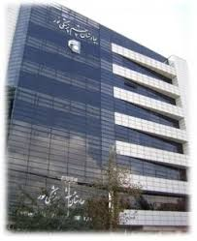
Thank you!
Noor Eye Hospital (NEI), Tehran, Iran
Milad Tower (Tehran, Iran)

